Slide 1


Slide 2
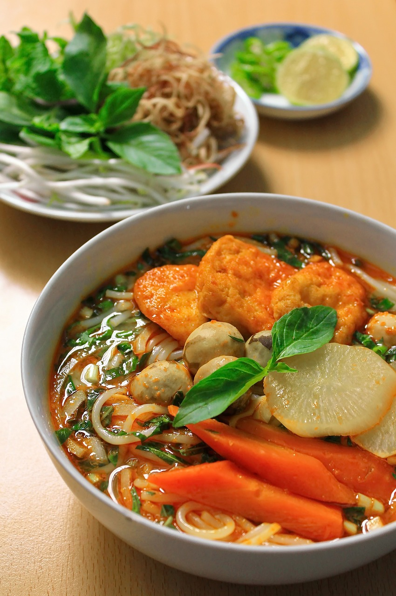
Disadvantages
of noodles

Slide 3
What is noodles?
Notes:
Instant Noodles are a popular dish because they are cheap, easy to cook and easy to buy on the street.

Slide 4
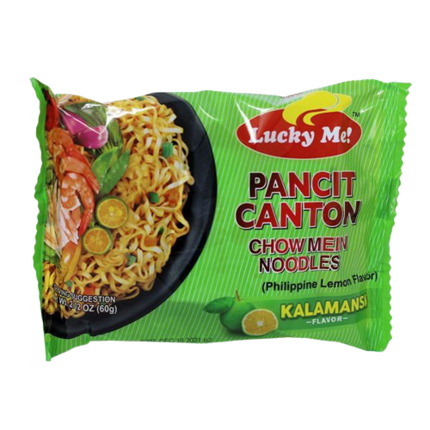
What are chemical in a packet of noodles?
Contain Sodium
Carbohydrate
Calories
Thiamine

Slide 5


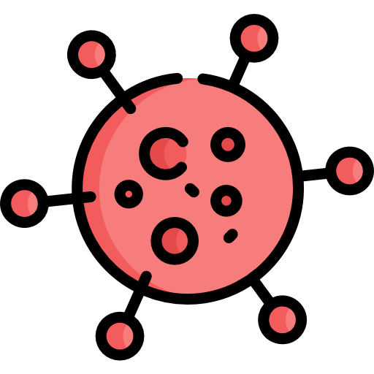
What are impacts of eating a lot of noodles?
Heart disease
High blood
Cause cancer

Slide 6
Do you want to have a good health?

Slide 7
Conclusion

Slide 8

Thank You!

